Slide 1
Java Server Pages
JSP

Slide 2
Outline
Introduction
How JSP works
JSP Scripting Elements
Implicit Objects
JSP Directives

Slide 3
Introduction
A Java Server Page is an HTML document that’s saved in a file with the extension .jsp instead of .htm or .html. Unlike servlet class files, you can store a JSP file in any directory that’s available to the Web server
JSPs are built on top of Servlet technology. JSPs are essential an HTML page with special JSP tags embedded. The JSP engine parses the .jsp and creates a Java servlet source file. It then compiles the source file into a class file, this is done the first time and this why the JSP is probably slower the first time it is accessed. Any time after this the special compiled servlet is executed and is therefore returns faster.

Slide 4
Introduction
Putting Java code along with HTML code.
Server-side of the web
JSP, ASP, PHP, and JavaScript
JSP Building elements:
  Scripting elements
  Directives
  Actions

Slide 5
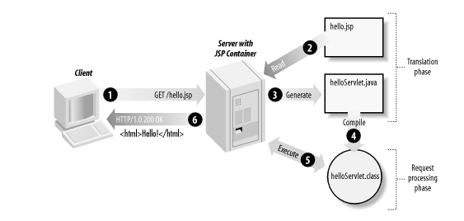
Figure 3-3. JSP page translation and processing phases
JSP Processing

Slide 6
How does JSP work?
JSP Document
Translation
.java file
Compilation
.class file
Reinitialization
.class file ready to run
Subsequent
User Requests
Response Document

Slide 7
JSP Advantages
JSP supports both scripting- and element-based dynamic content, and allows developers to create custom tag libraries to satisfy application-specific needs.
JSP pages are compiled for efficient server processing.
JSP pages can be used in combination with servlets that handle the business logic, the model favored by Java servlet template engines.
JSP is a specification, not a product. This means vendors can compete with different implementations, leading to better performance and quality.
JSP is an integral part of J2EE, a complete platform for enterprise class applications. This means that JSP can play a part in the simplest applications to the most complex and demanding.

Slide 8
JSP Advantages
JSP vs. Active Server Pages (ASP) ASP is a similar technology from Microsoft. The advantages of JSP are twofold. First, the dynamic part is written in Java, so it is more powerful and easier to use. Second, it is portable to other operating systems and non-Microsoft Web servers.
JSP vs. Pure Servlets JSP is more convenient to write (and to modify!) regular HTML than to have a println statements that generate the HTML. Plus, by separating the look from the content you can put different people on different tasks; your Web page design experts can build the HTML, leaving places for your servlet programmers to insert the dynamic content.

Slide 9
JSP Advantages
JSP vs. Server-Side Includes (SSI) SSI is a widely-supported technology for including externally-defined pieces into a static Web page. JSP is better because it lets you use servlets instead of a separate program to generate that dynamic part. Besides, SSI is really only intended for simple inclusions, not for "real" programs that use form data, make database connections.
JSP vs. JavaScript JavaScript can generate HTML dynamically on the client. This is a useful capability, but only handles situations where the dynamic information is based on the client's environment. With the exception of cookies, HTTP and form submission data is not available to JavaScript. And, since it runs on the client, JavaScript can't access server-side resources like databases, catalogs, pricing information.

Slide 10
Designing Your first JSP
<html>
<head>
<title>First JSP page.</title>
</head>
<body><font color=“red” size=“6”>
<%="Java Developers Paradise"%></font>
<font color=“blue” size=“6”><%="Hello JSP"%> </font>
</body>
</html>

Slide 11
javax.servlet.jsp package defines two classes:
• JSPPage
• HttpJspPage

Slide 12
These classes defines the interface for the compiled JSP page. These interfaces are:
jspInit()
jspDestroy()
_jspService(HttpServletRequest request,HttpServletResponse response)

Slide 13
In the compiled JSP file these methods are present. Programmer can define jspInit() and jspDestroy() methods, but the _jspService(HttpServletRequest request,HttpServletResponse response) method is generated by the JSP engine.

Slide 14
Scripting Elements(1)
Comment Element: Used to clarify the logic of the JSP code.
  <%-- Your Comment --%>
  Example:
<%-- This is to display today’s date on the page --%>
<%
Out.print(new java.util.Date());
%>

Slide 15
Scripting Elements(2)
Declaration Element
  It has the form <%! Your declaration %>
  It is used to declare class members; variables or methods. It does not have any other code than declaratives.
  Class members created here will last forever as long as the class object is alive.
  Example:
<%!
int x = 0;
int square(int x){
return x * x;
}
%>

Slide 16
Scripting Elements(3)
Expression Element
  It has the format <%= your expression %>
  An expression in this context is not a complete java statement; it is just a part of it.
  Example:
<p> The square of <%= x%> is <%= square(x) %> as calculated by a JSP program.</p>

Slide 17
Scripting Elements(4)
Scriptlets
  A scriptlet is a piece of Java code sandwiched between <% and %>
  A scriptlet can make use of any java API as long as it is appropriate for the web purpose.
  Variables defined in a scriptlet are local.
  Example:
<%
for(int i=1; i <= 10; i++){
out.print(“hello world!<br>”);
}
%>

Slide 18
Mapping a JSP Document to a Java Class
JSP Document
<html>
<head><title> test</title></head>
<body>
<%! Declaration 1%>
<% scriptles 1%>
<% scriptlet 2%
<%= expression %>
<%! Declaration 2%>
</body>
</html>
Java Class
class doc-name-1 …{...
//declaration 1 here
//Declaration 2 here
public void _jspService(…){...
//Scriptlet 1 here
//Scriptlet 2 here
// Expression here
...
}
...
}

Slide 19
Implicit Objects
JSP container provides you- the developer with tools necessary for your JSP document to interact with the environment surrounding it.
Of the implicit objects, there are three most used implicit objects that are used to handle the current session , the incoming request, and the outgoing response. These three are session, request, and response respectively.

Slide 20
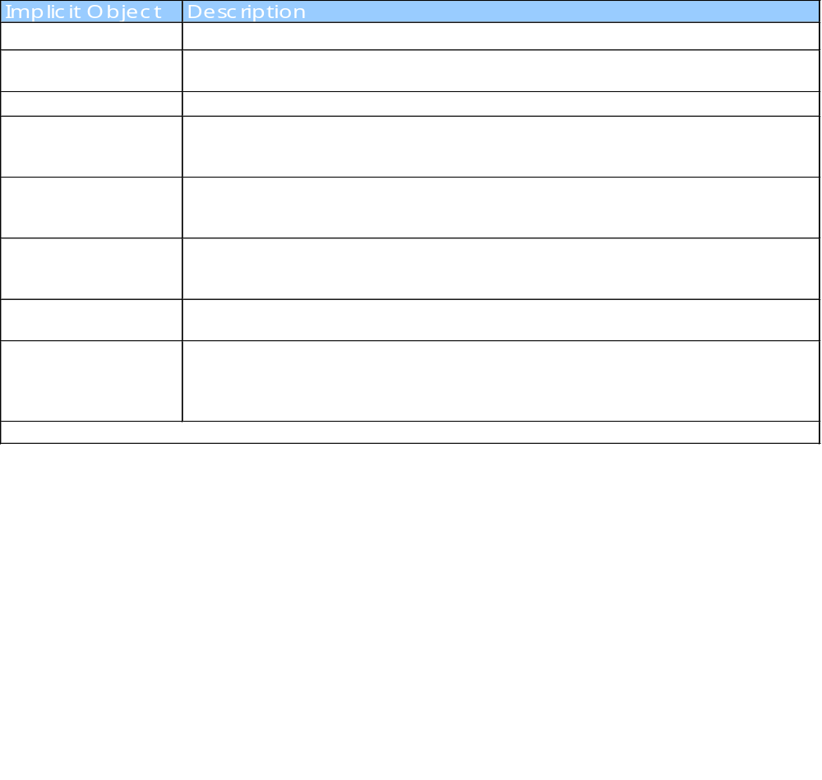
Implicit Objects

Slide 21
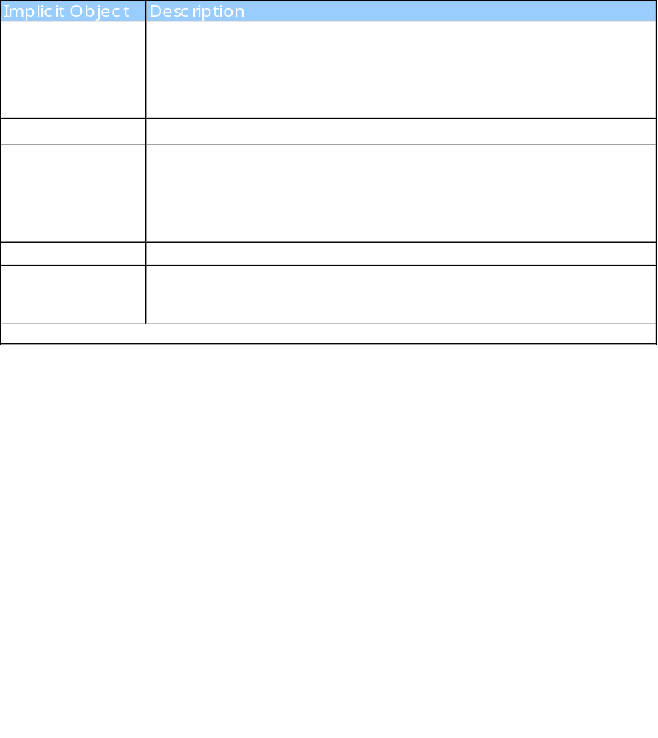
Implicit Objects

Slide 22
Processing HTML Forms
JSP is a good replacement to the CGI scripts running behind the HTML forms.
JSP saves you the trouble of parsing the data coming from the client browser.
It takes just to call method request.getParameter(“param-name”) to get the data sent by the client browser.

Slide 23
JSP Directives
JSP Supports what is called JSP directives.
JSP directives are like SSI and not written in Java.
They look like: <%@ directive %>
There are three directives defined by JSP; include, page, and taglib
Examples:
<%@ page language=“java” import=“java.util.*”%>
<%@ include file=“filename”%>

Slide 24
JSP Directives
The page Directive :- The page directive is used to provide instructions to the container that pertain to the current JSP page. You may code page directives anywhere in your JSP page. By convention, page directives are coded at the top of the JSP page.
Following is the basic syntax of page directive:
<%@ page attribute="value" %> You can write XML equivalent of the above syntax as follows:
<jsp:directive.page attribute="value" />
Attributes:
Following is the list of attributes associated with page directive:

Slide 25
Attribute | Purpose
buffer | Specifies a buffering model for the output stream. Buffer size
autoFlush | Controls the behavior of the servlet output buffer. True or False
contentType | Defines the character encoding scheme. Text /html , character set
errorPage | Defines the URL of another JSP that reports on Java unchecked runtime exceptions. Error page URL .
isErrorPage | Indicates if this JSP page is a URL specified by another JSP page's errorPage attribute. True , false
extends | Specifies a superclass that the generated servlet must extend. somePackage.SomeClass
import | Specifies a list of packages or classes for use in the JSP as the Java import statement does for Java classes.
info | Defines a string that can be accessed with the servlet's getServletInfo() method. Extra Info.
isThreadSafe | Defines the threading model for the generated servlet. True or False.
language | Defines the programming language used in the JSP page.
session | Specifies whether or not the JSP page participates in HTTP sessions

Slide 26
include Directive
The include directive is used to includes a file during the translation phase. This directive tells the container to merge the content of other external files with the current JSP during the translation phase. You may code include directives anywhere in your JSP page.
The general usage form of this directive is as follows:
<%@ include file="relative url" > The filename in the include directive is actually a relative URL. If you just specify a filename with no associated path, the JSP compiler assumes that the file is in the same directory as your JSP.
You can write XML equivalent of the above syntax as follows:
<jsp:directive.include file="relative url" />

Slide 27
include Directive
Example:
A good example of include directive is including a common header and footer with multiple pages of content.
Let us define following three files (a) header.jps (b)footer.jsp and (c)main.jsp as follows:
Following is the content of header.jsp:

Slide 28
Header.jsp:-
<%!
int pageCount = 0;
void addCount() {
pageCount++;
}
%>
<% addCount(); %>
<html>
<head>
<title>The include Directive Example</title>
</head>
<body>
<center>
<h2>The include Directive Example</h2>
<p>This site has been visited <%= pageCount %> times.</p>
</center>
<br/><br/>

Slide 29
Footer.jsp :-
<br/><br/>
<center>
<p>Copyright © 2010</p>
</center>
</body>
</html>
Main.jsp:-
<%@ include file="head.jsp" %>
<center>
<p>Thanks for visiting my page.</p>
</center>
<%@ include file="foot.jsp" %>

Slide 30
taglib Directive
The JavaServer Pages API allows you to define custom JSP tags that look like HTML or XML tags and a tag library is a set of user-defined tags that implement custom behavior.
The taglib directive declares that your JSP page uses a set of custom tags, identifies the location of the library, and provides a means for identifying the custom tags in your JSP page.
The taglib directive follows the following syntax:
<%@ taglib uri="uri“ prefix="prefixOfTag" >
Where the uri attribute value resolves to a location the container understands and the prefix attribute informs a container what bits of markup are custom actions.
You can write XML equivalent of the above syntax as follows:
<jsp:directive.taglib uri="uri" prefix="prefixOfTag" />
When you use a custom tag, it is typically of the form <prefix:tagname>. The prefix is the same as the prefix you specify in the taglib directive, and the tagname is the name of a tag implemented in the tag library

Slide 31
Action tags
ACTION TAGS are three types
  FORWARD ACTION
  INCLUDE ACTION
  USEBEAN ACTION

Slide 32
Action Elements
Action elements are tags that affect the runtime behavior of a JSP
Action elements are also known as Standard Actions
Some common standard actions are
  <jsp:forward>
  <jsp:include>
  <jsp:useBean>
  <jsp:setProperty>
  <jsp:getProperty>
  <jsp:param>

Slide 33
Standard Actions - jsp:forward
The <jsp:forward> tag is used to forward a request to
another page
The control will be given to the target page
The syntax of the tag is as follows
Static url or computed at request time.
  <jsp:forward page = “Relative url” />
We can pass parameters to the forwarded page using <jsp:param> tag
The syntax of using the jsp:param tag is as follows
  <jsp:forward page = “url”>
  <jsp:param name = “name” value = “value” />
  </jsp:forward>
  <jsp:forward page = “<%=java expression %>” />

Slide 34
Standard Actions - jsp:include
The <jsp:include> tag is used to include the contents of
another file in a JSP
The syntax of the tag is as follows
  <jsp:include page = “Relative url” />
Unlike the include page directive that pastes the contents of the included file as a part of the JSP, the <jsp:include> tag acts at run time i.e., This action inserts the file at the time the page is requested but not at the time the JSP page is translated into a servlet as like Action Directives
If the included file is modified, the next request will receive the modified content in the case of <jsp:include>

Slide 35
Standard Actions - jsp:useBean, jsp:setProperty, jsp:getProperty
Minimizing Java code in a JSP will enable even a web designer to maintain it
To separate presentation from code, we can encapsulate the logic in a JavaBean
JSP can instantiate a JavaBean using the <jsp:useBean> tag, set the bean properties using the <jsp:setProperty> tag and get the bean properties using the <jsp:getProperty> tag
syntax:
  <jsp:useBean id="name" class="package.class" />
  Attributes: id, class, scope, type, beanName
  scope: page | request | session | application

Slide 36
Standard Actions - jsp:useBean
The <jsp:useBean> tag can be used to create a bean object
The important attributes of <jsp:useBean> tag are
  id
  class
  scope
The id attribute
  Specifies the name of the Bean object
The class attribute
  Specifies the fully qualified name of the Bean class
The scope attribute
  Specifies the scope of the Bean object as page, request, session or application

Slide 37
Standard Actions - jsp:useBean
The page scope
  Available only for this request and only in this page
  By default, the scope will be page
The request scope
  Available only for this request
  Available to other forwarded and included JSPs
The session scope
  Available to the current session
The application scope
  Available to any JSP in the same application

Slide 38
Standard Actions - jsp:useBean
The <jsp:useBean> tag for instantiating the WishBean is as follows
<jsp:useBean id = "myWishBean" class = “mypackage.WishBean"/>
The above tag is equivalent to the following Java code
mypackage.WishBean myWishBean = new mypackage.WishBean();

Slide 39
jsp:setProperty
It is used to sets values to properties of beans in two ways
1. use it after, but outside of a jsp:useBean element, which is executed regardless of whether a new bean was instantiated or an existing bean was found.
<jsp:useBean id="myName" .../ >...
<jsp:setProperty name="myName” property=“anyProperty”… />
2. appears inside the body of a jsp:useBean element, which is executed only if a new object was instantiated, not if an existing one was found.
<jsp:useBean id="myName" ... > ...
<jsp:setProperty name="myName” property=“anyProperty”… />
</jsp:useBean>

Slide 40
Standard Actions - jsp:setProperty
The <jsp:setProperty> tag can be used to set the Bean properties
The attributes are
  name
  property
  param
  value
The name attribute
  Specifies the id of the Bean object

Slide 41
Standard Actions - jsp:setProperty
The property attribute
  Specifies the name of the bean property that is to be set
  If this attribute is *, all the request parameters will be assigned to bean properties based on matching name
  If the request parameter is having a value “”, the bean property is left unaltered
The param attribute
  Specifies the name of the request parameter whose value is to be put in to the bean property
  If this value is not specified, the value of the request parameter whose name is same as that of the bean property will be assigned to the bean property

Slide 42
Standard Actions - jsp:setProperty
The value attribute
  Specifies the value to be assigned to the bean property
<jsp:setProperty name=“myWishBean” property=“wish” value=“Welcome” />
The above tag is equivalent to the following Java code
myWishBean.setWish(“Welcome”);

Slide 43
jsp:getProperty
This element retrieves the value of a bean property, converts it to a string, and inserts it into the output.
The two required attributes are name of a bean, and property whose value should be inserted.
<jsp:useBean id="itemBean" ... />...
<UL>
<LI>Number of items:
<jsp:getProperty name="itemBean" property="numItems" />
<LI>Cost of each:
<jsp:getProperty name="itemBean" property="unitCost" />
</UL>

Slide 44
Standard Actions - jsp:getProperty
The <jsp:getProperty> tag can be used to get the value of a bean property
The attributes are
  name
  property
The name attribute
  Specifies the id of the Bean object
The property attribute
  Specifies the name of the bean property to get

Slide 45
Standard Actions - jsp:getProperty
The <jsp:getProperty> can be used to get the property wish of the WishBean as follows
<jsp:getProperty name = "myWishBean" property = "wish" />
The above tag is equivalent to the following Java code
myWishBean.getWish();

